Slide 1
How the Blockchain will Improve Healthcare
Randy Piper & Chris Moreland

Slide 2
Agenda
Some healthcare supply-chain challenges
Current state
Better state
What is blockchain
Key components of ledger technology
Who is using blockchain to improve their business

Slide 3
Healthcare Supply-chain Challenges
20 million transactions each day, or about 7 billion transactions per year.
Accuracy is a challenge:
Pricing
Unit of Measure
Product description
Security
Access to information
Manual process

Slide 4
Current State
Centralized around legacy systems, customized software
Many established processes
Problem resolution is largely a manual process
Chargebacks and rebates
Disparate data
Security
Access to information

Slide 5
What If...
...data including pricing/eligibility could be securely and automatically verified in realtime?
...no change in current legacy systems and minimal disruption to current processes was required?
...the need to continually clean product item files via expensive consulting engagements was minimized or eliminated?

Slide 6
What is Blockchain?
Block Chain is NOT Bitcoin !
Blockchain allows people to exchange assets and perform transactions without a third party.
Blockchains are often referred to as digital decentralized ledgers.
Blockchain is a grouping of many technologies packaged in a new way
Has its roots in Accounting. Allowing for triple entry ledgers.

Slide 7
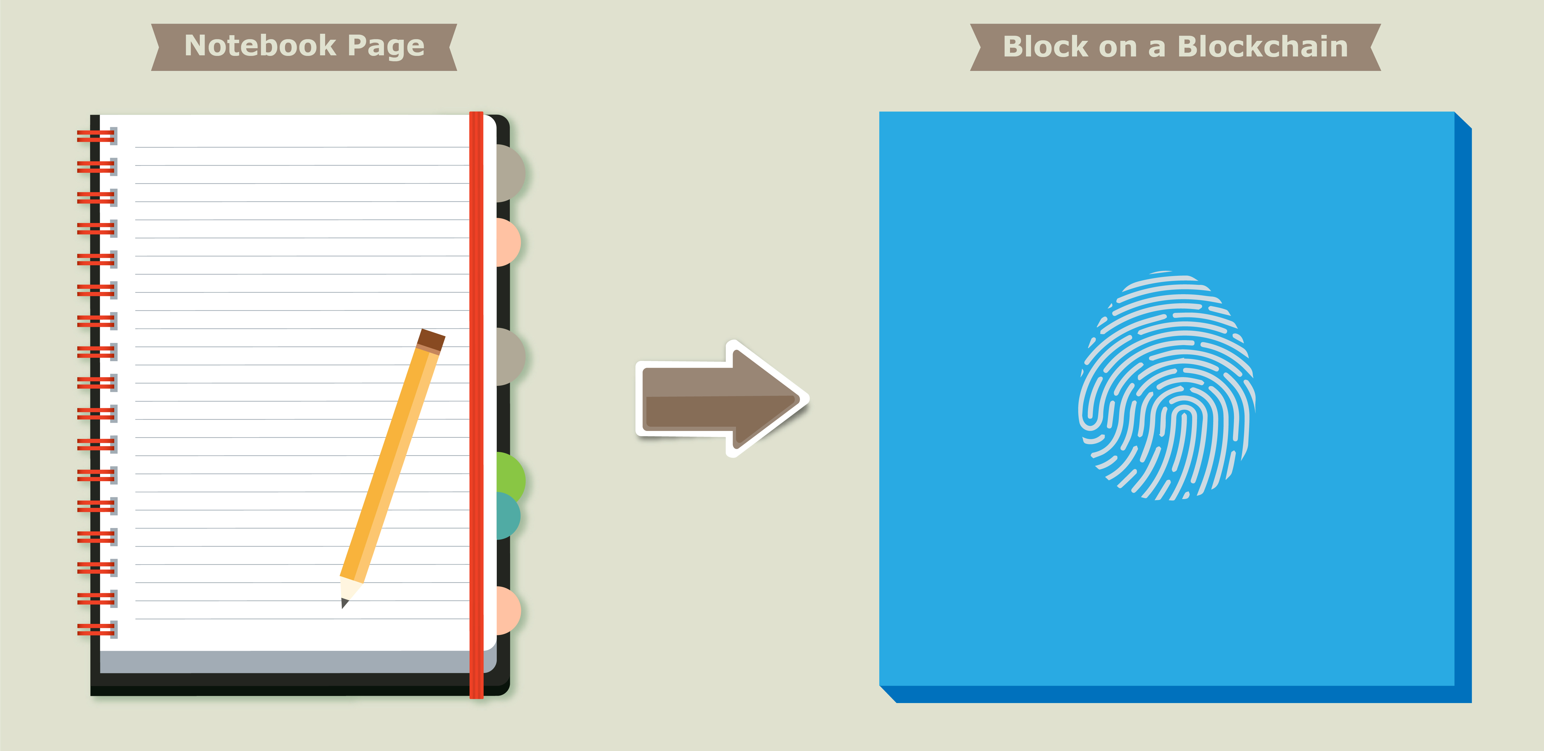
Concepts
A block on a blockchain can be thought of much like a page in a notebook. Data is stored on a block, just like data is written on a page of a notebook.

Slide 8
Components Overview Ledger: A distributed, immutable historical record Peer Network: Stores, updates, and maintains the ledger Membership Services: User authentication, authorization, and identity management Smart Contract: Program that runs on the blockchain Wallet: Stores users' credentials Events: Notifications of updates and actions on the blockchain Systems Management: Component creation, modification, and monitoring Systems Integration: Integration of blockchain with external systems.

Slide 9
Components Ledger: The goal of the blockchain is to create a distributed, immutable record of the history of the blockchain called the ledger. Peer Network: Stores, updates, and maintains the ledger The ledger is stored, updated, and maintained by a peer network. Each node in this network maintains its own copy of the ledger. It is the job of the network as a whole to come to a consensus on the contents of each update to the ledger. This ensures that each individual copy of the ledger is identical without requiring a centralized "official” copy of the ledger. Membership Services: User authentication, authorization, and identity management On some blockchains, anyone can join the peer network and all network members have equal powers and authority. Permissioned blockchains require authorization to join and Membership Services authenticates, authorizes, and manages the identity of users on the blockchain.

Slide 10
Components Smart Contract: Program that runs on the blockchain The original blockchains were designed to simply allow financial transactions to be performed and stored in the historical ledger, and had limited configurability. Since then, blockchains have evolved so that some have become fully functional distributed computers. Smart contracts are programs that run on the blockchain. Users can interact with smart contracts in a similar way that they interact with programs on a standard computer. Wallet: Stores users credentials In blockchain, the user's wallet stores their credentials and tracks digital assets associated with the user's address. The wallet tracks user credentials and any other information that may be associated with their account. Events: Notifications of updates and actions on the blockchain The blockchain’s ledger and the state of the peer network are updated by events. Examples of events include the creation and dispersion of a new transaction across the peer network and the addition of a new block to the blockchain. Events may also include notifications from smart contracts on blockchains that support such contracts.

Slide 11
Components Systems Management: Component creation, modification, and monitoring The blockchain is designed to be a long-lived system in a field that is constantly evolving. Systems management provides the capability of creating, modifying, and monitoring blockchain components to meet the needs of its users. Systems Integration: Integration of blockchain with external systems As blockchain has evolved and increased in functionality, it has become more common to integrate blockchains with other external systems, commonly through the use of smart contracts. While this is not a specific component of the blockchain, systems integration is included to acknowledge this capability.

Slide 12
Who is using blockchain?
Bank of America
Bank of America has recently applied for nine more blockchain related patents, a sign that the bank is open to using Blockchains in its operations. Bank of America hopes to use open-sourced ledgers to create more efficient financial transactions for consumers and business. Combined with Ripple’s XRP token, Bank of America could save billions of dollars every year in cross-border payments.
Mastercard
Mastercard has filed over 30 Blockchain related patents, some under the title of “Method and System For Instantaneous Payment using Recorded Guarantees,” which seems to imply that they are building their own Blockchain based payment gateways. Bitcoin has been said to be disruptive to payment processors like Mastercard and VISA so it makes sense that they would explore their private alternatives to Bitcoin-based payments.

Slide 13
Who is using blockchain?
Walmart
Walmart and nine other food companies have partnered with IBM to create a Blockchain for tracking food globally through its supply chain. Real-time data will be captured at every point, on every single food product. The Food Trust Blockchain, which includes Nestlé SA, Dole Food Co., Unilever, and several others. These companies have been collaborating with IBM on the initiative since 2016 and began conducting trials of the product in August of last year. Their goal is to improve the companies’ ability to identify issues involved with food recalls, such as tracing outbreaks more quickly to limit customer risk. Walmart appears to have joined the initiative after the outbreak of salmonella in the supply chain last year.
Get In Unison Ltd.
First to market in healthcare.

Slide 14
Questions

